Slide 1
Wheel velocity
1
0
1
0
2
3
2
3

Slide 2



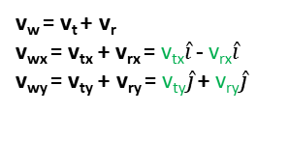

x
y
$\hat{i}$
v_{w} = v_{t} + v_{r}
$\hat{j}$
(1,0)
v_{r}
(0,1)
v_{t}
v_{t} = v_{tx}+ v_{ty} = v_{tx}$\hat{i}$ + v_{ty}$\hat{j}$
v_{t}
v_{tx}
v_{ty}
1
0
v_{rx} = 𝜔*perpendicular radius
= 𝜔*0.5*W
v_{ry} = 𝜔*0.5*L
v_{w} = v_{t} + v_{r}
v_{wx} = v_{tx} + v_{rx} = v_{tx}$\hat{i}$ - v_{rx}$\hat{i}$
v_{wy} = v_{ty} + v_{ry} = v_{ty}$\hat{j}$ + v_{ry}$\hat{j}$
$$ω$$
2
3

Slide 3

width
1
R
0
length
$$ω$$
2
3

Slide 4
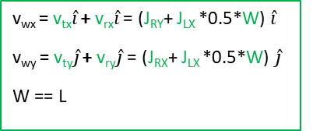
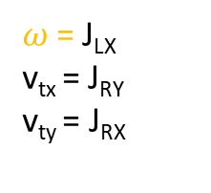
Controls rotation
Controls translation
J_{LY}
J_{RY}
J_{LX}
J_{RX}
$ω$ = J_{LX}
v_{tx} = J_{RY}
v_{ty} = J_{RX}
v_{wx} = v_{tx}$\hat{i}$ + v_{rx}$\hat{i}$ = (J_{RY}+ J_{LX} *0.5*W) $\hat{i}$
v_{wy} = v_{ty}$\hat{j}$ + v_{ry}$\hat{j}$ = (J_{RX}+ J_{LX} *0.5*W) $\hat{j}$
W == L
x
y
Speed 0 = 2/2 = 1
Speed 1 = 1.5/2 = 0.75
Speed 2 = 0.8/2 = 0.4
Speed 3 = 0.5/2 = 0.25
drive motor speed = sqrt(v_{wx}^2 + v_{wy}^2)
azimuth motor angle = arctan(v_{wy}/v_{wx})
Speed 0 = 0.5/0.8 =
Speed 1 = 0.3/0.8 =
Speed 2 = 0.8/0.8 = 1
Speed 3 = 0.5/0.8 = 0.625

Slide 5

1
0
V3 = r3*$ω$
V2 = V3*r2/r3
V1 = V3*0/r3
2
3
P=1

